Slide 1
ECE 322L Electronics 2
04/16/20 - Lecture 22
Class A and class B amplifiers

Slide 2
Overview
Classes of amplifiers
(Neamen 8.3 and 8.4-S&S, 6th edition, 11.1)
Class A power amplifiers
(Neamen 8.3.1 and 8.4-S&S, 6th edition, 11.2)
Class B power amplifiers
(Neamen 8.3.2 and 8.4-S&S, 6th edition, 11.3)

Slide 3
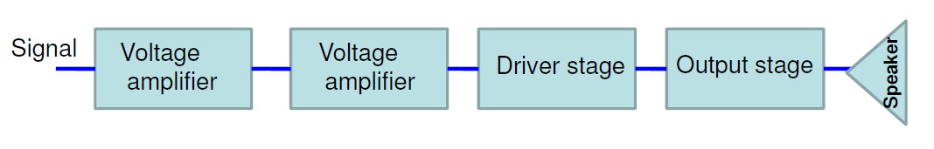
Power amplifiers
Large-signal amplifier
Generally the last stage of a multistage amplifier.
The function of a practical power amplifier is to deliver high power to an output device, such as a loud speaker.
Typical output power rating of a power amplifier will be 1W or higher. The schematic diagram of a multi-stage amplifier utilizing a power amplifier is shown below –
Power amplifier

Slide 4
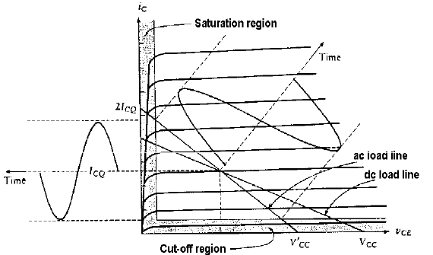
Power amplifiers
A Power amplifier utilizes a large portion of the ac load-line.
As a result of the signal being large
distortion may easily occur
the small-signal approximation cannot be used to calculate the parameters of the amplifier.

Slide 5

Performance parameters of a power amplifier
Amplifier Efficiency :
Ratio of the average power transferred to the load and the average supplied power.
Total harmonic distortion (THD)
It quantifies the change in output waveform relatively to the input waveform.
Power dissipation capability
Ability of a power amplifier to dissipate heat.

Slide 6
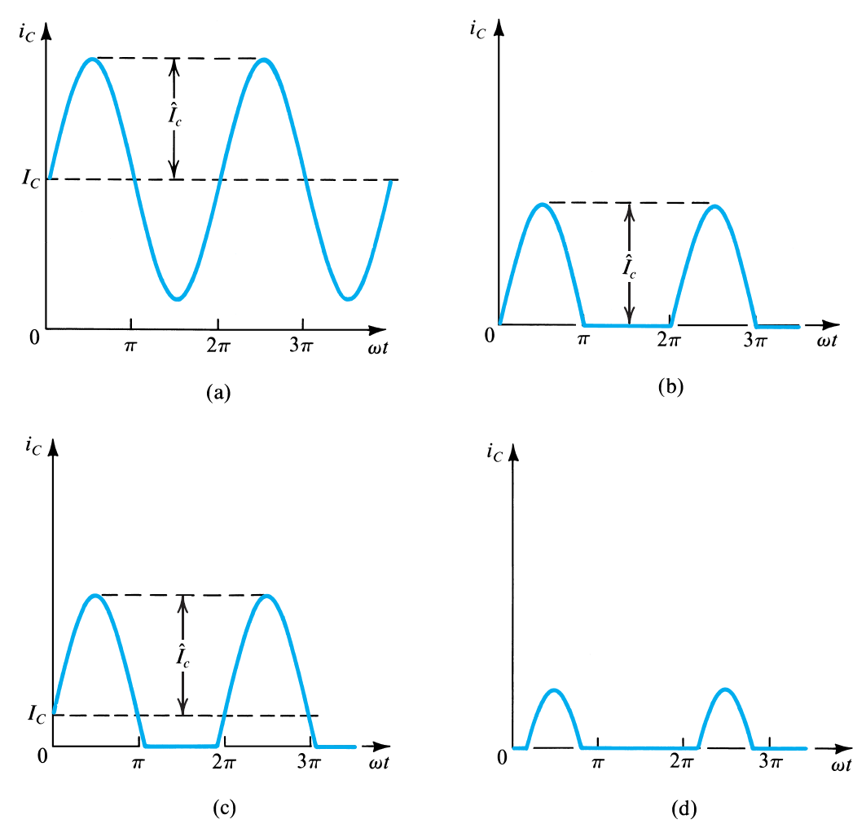
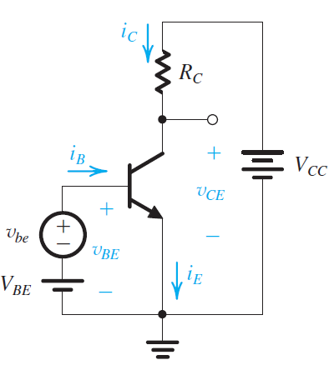
Classes of amplifiers
Amplifiers are classified according to the collector current waveform that results when an input signal is applied.
class A
class B
class AB
class C
v_{be} sinusoidal function

Slide 7
Classes of amplifiers
class A
class B
class AB
class C
Class-A: Output device(s) conduct through 360 degrees of input cycle (never switch off).
Class-B: Output devices conduct for 180 degrees (1/2 of input cycle).
Class-AB: Halfway (or partway) between the above two examples (181 to 200 degrees typical).
Class-C: Output device(s) conduct for less than 180 degrees (100 to 150 degrees typical)

Slide 8
Classes of amplifiers
class A
class B
class AB
class C
Each class is characterized by different values of performance parameters, namely efficiency, total harmonic distortion and power dissipation capability.
Hence, different classes of amplifiers are suitable for different applications/stages.

Slide 9
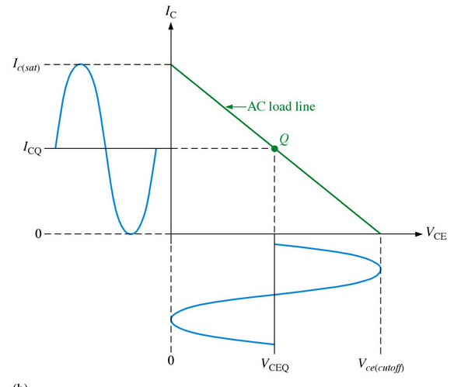
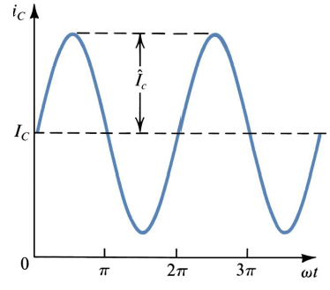
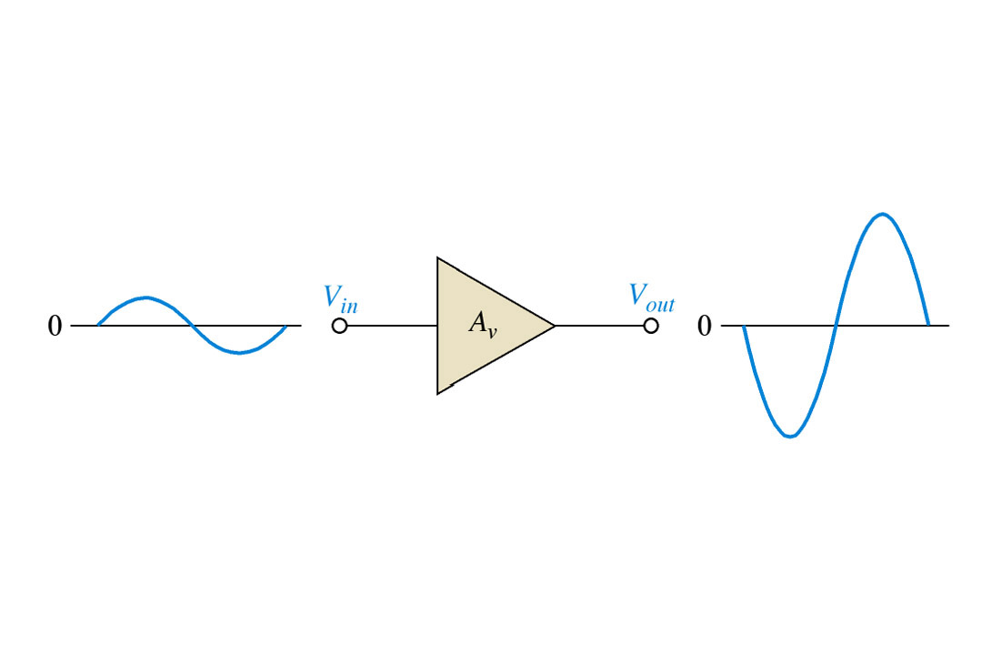
Class A amplifier
Class-A: Output device(s) conduct through 360 degrees of input cycle (never switch off).
Class A output stage is a simple linear current amplifier.
.

Slide 10
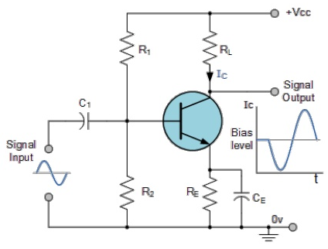
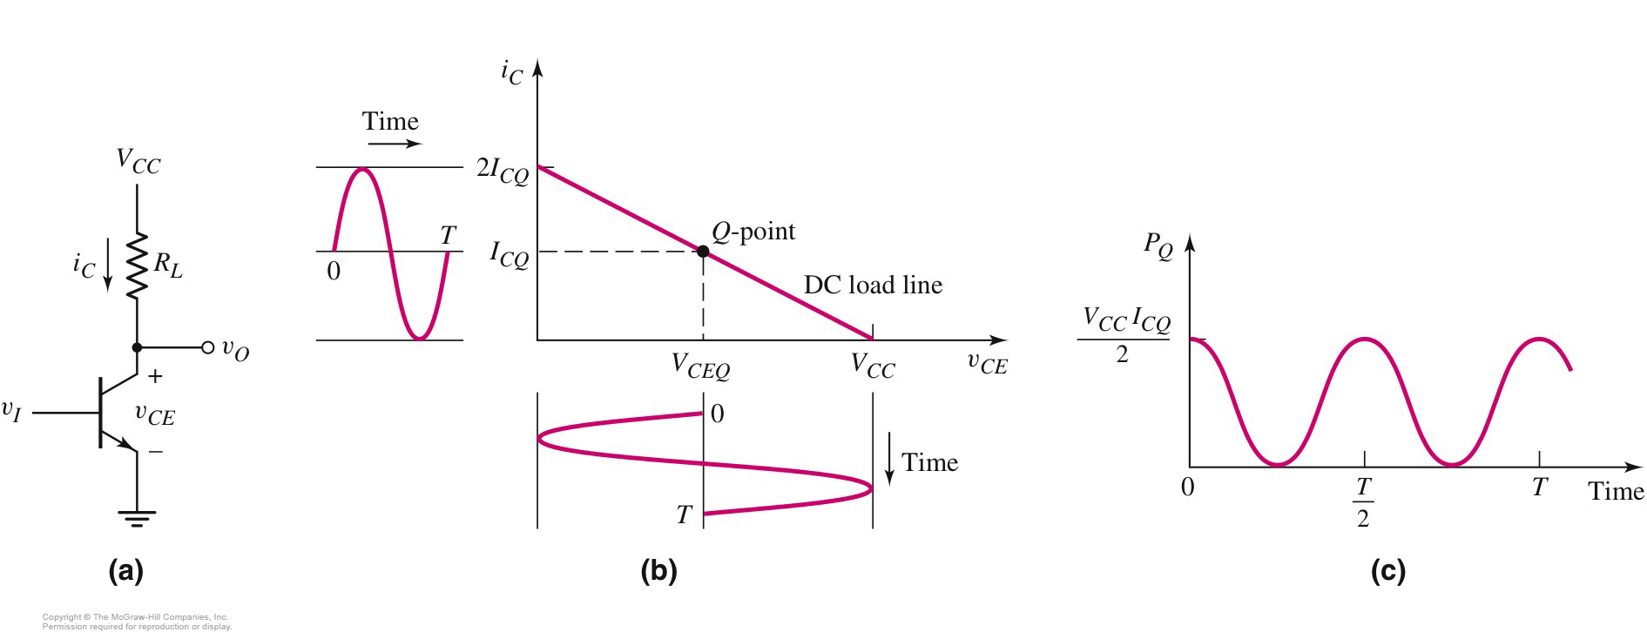
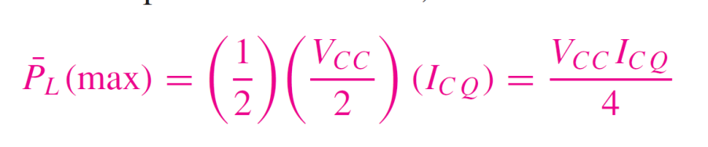
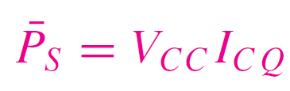
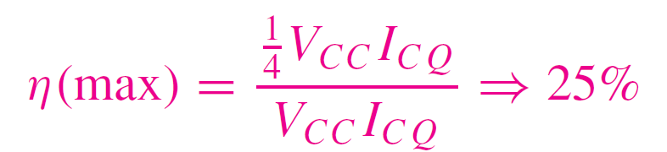

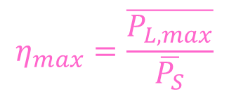

Maximum efficiency of class A amplifiers
$$η_{max}=\frac{\overline{P_{L,max}}}{\overline{P_{S}}}$$
$$\overline{P_{L}}=V_{omax,rms}I_{omax,rms}$$
$\overline{P_{L}}$= $\frac{V_{o,pmax}}{\sqrt{2}}\frac{I_{o,pmax}}{\sqrt{2}}$
Assumption: Q point is in the middle of the
active region

Slide 11
Instantaneous power dissipated by the transistor
It is independent on the amplitude of the output signal
The BJT must be continuously able to handle the maximum dissipated power

Slide 12
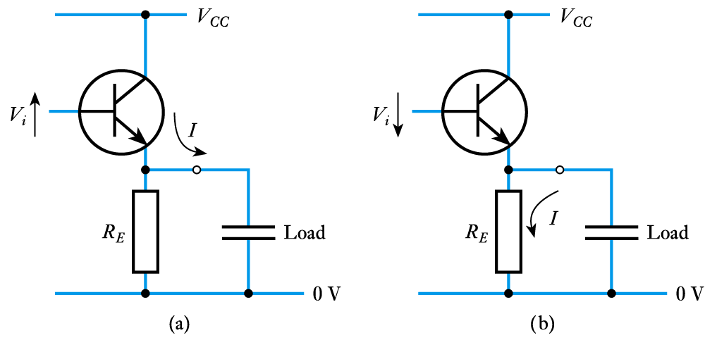
Why is class A so inefficient ?
The load applied to a power amplifier is not simply resistive but also has an inductive or capacitive element.
As a result power is only supplied to the load during half a period. In the other half of the period the load supplies power to the biasing network.

Slide 13
Why is class A so inefficient ?
Single transistor can only conduct in one direction. Hence the biasing network dissipates the power supplied by the load.
While the transistor is on and dissipates power during the whole period of the input signal, power is only transferred to the load during half a cycle.

Slide 14
Class A amplifier
A class A amplifier is a simple linear amplifier.
It is also very inefficient, typical maximum efficiency is between 10 and 20 %.
Only suitable for low power applications.
High power requires much better efficiency.

Slide 15
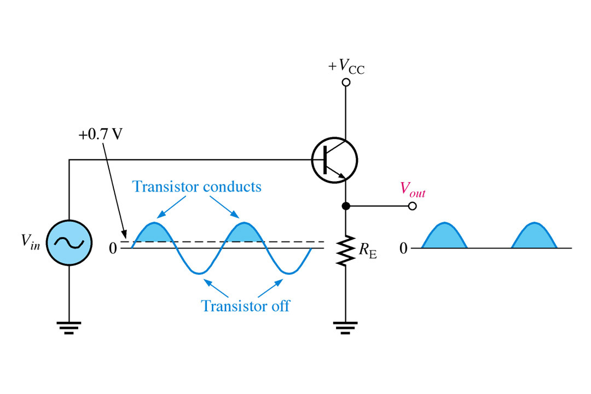
Class B amplifier
Individual output devices conduct for 180 degrees (1/2 of input cycle)

Slide 16
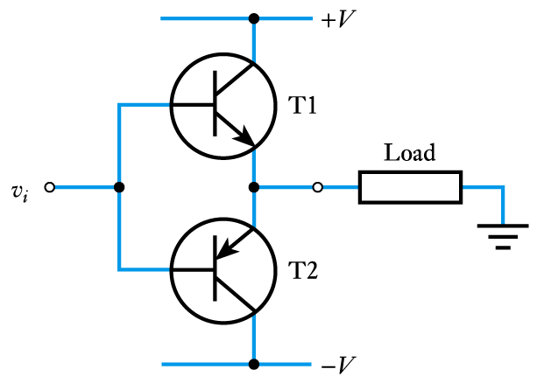
Push-pull class B amplifiers
Useful implementation of a class B amplifier
This circuit is both a good current source and a good current sink

Slide 17
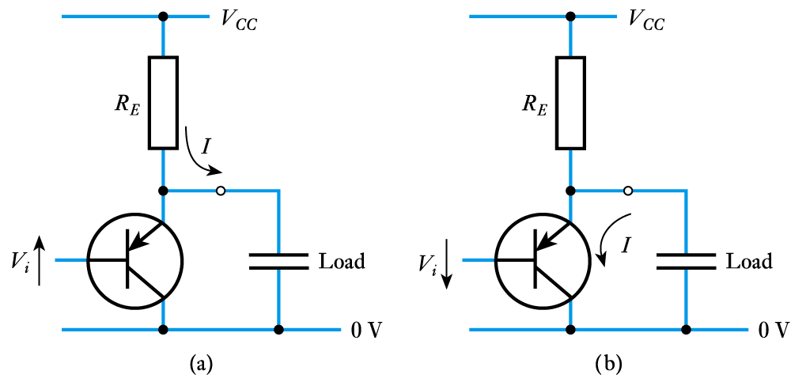
Class B amplifier
Useful implementation of a class B amplifier
npn is a good current source
npn is a bad current sink
pnp is a bad current source
pnp is a good current sink

Slide 18
Push-pull class B amplifiers
Useful implementation of a class B amplifier
This circuit is both a good current source and a good current sink

Slide 19
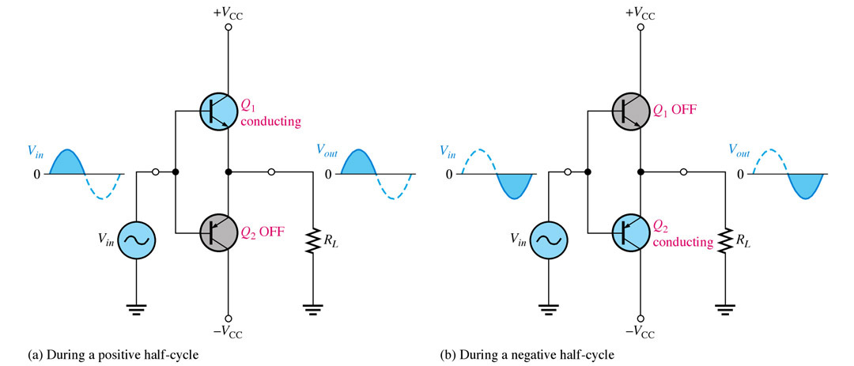
Push-pull class B amplifiers
Q₁ and Q₂ form two unbiased emitter followers
Q₁ only conducts when the input is positive
Q₂ only conducts when the input is negative
Conduction angle per each BJT is, therefore, 180° (Class B amplifier)
When the input is zero, neither conducts, i.e. the quiescent power dissipation is zero!

Slide 20
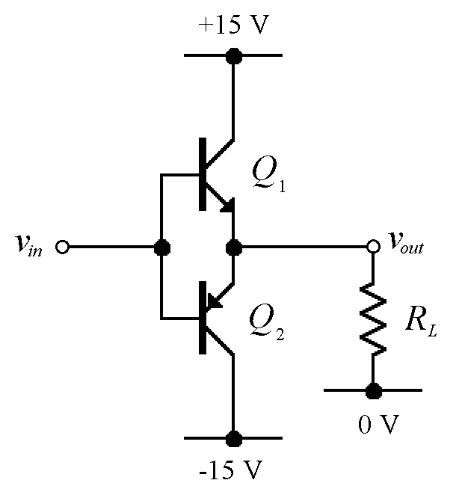
Class B Current Waveforms
I_{out}
time
I_{C1}
time
I_{C2}
time

Slide 21
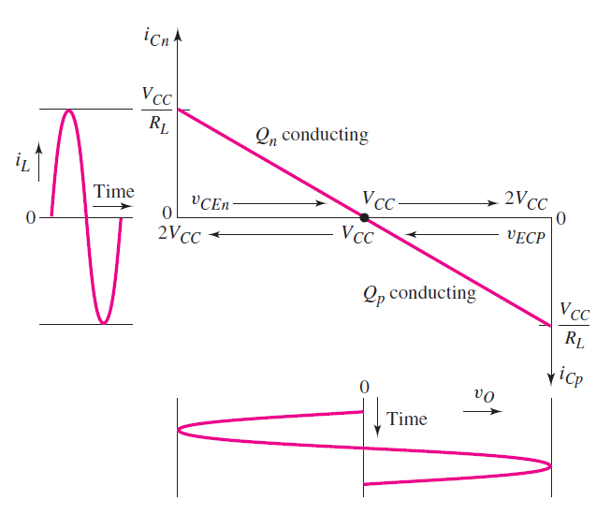
Load line of a push-pull amplifier

Slide 22
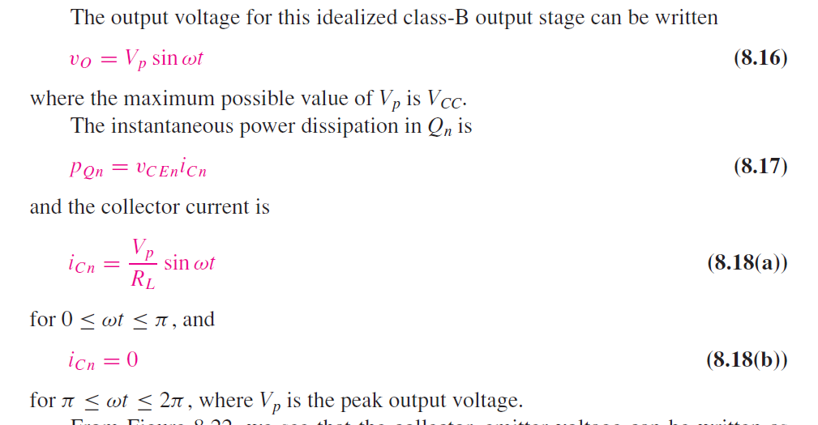

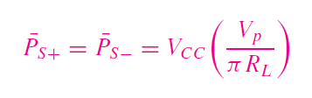
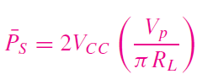
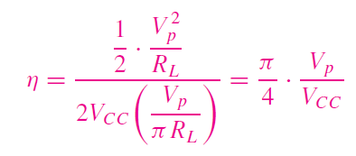

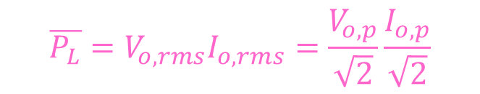

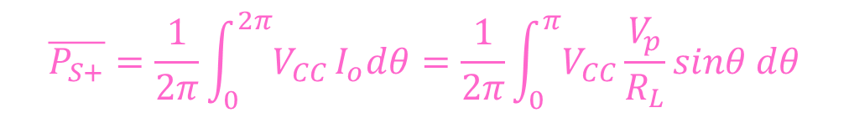
Efficiency of a push-pull amplifier
$$i_{o}=\frac{v_{o}}{R_{L}}=\frac{V_{p}sinωt}{R_{L}}$$
$$\overline{P_{L}}=V_{o,rms}I_{o,rms}=\frac{V_{o,p}}{\sqrt{2}}\frac{I_{o,p}}{\sqrt{2}}$$
$$\overline{P_{S}}=\overline{P_{S+}}+\overline{P_{S−}}$$
$$\overline{P_{S+}}=\frac{1}{2π}\int_{0}^{2π}{V_{CC}}I_{o}dθ=\frac{1}{2π}\int_{0}^{π}{V_{CC}}\frac{V_{p}}{R_{L}}sinθ dθ$$

Slide 23
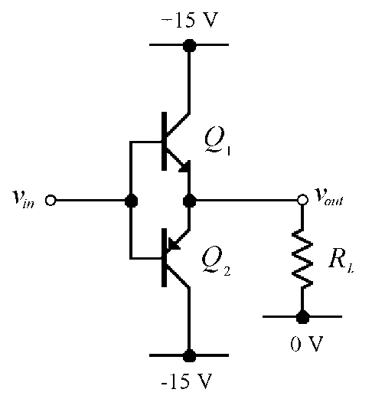
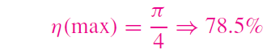
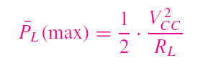
Efficiency of a push-pull amplifier
The max possible V_{p}= V_{CC}, hence

Slide 24

Dissipated power in a push-pull amplifier

Slide 25
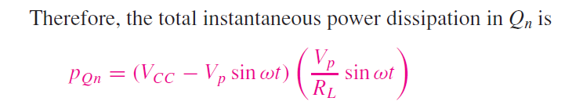
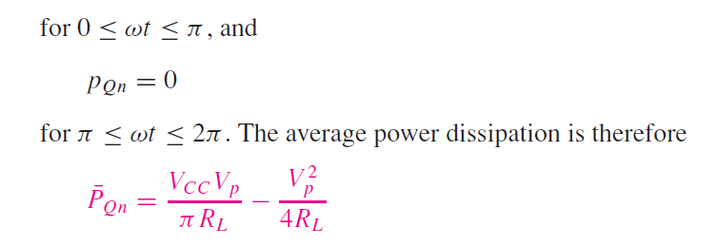
Dissipated power in a push-pull amplifier

Slide 26
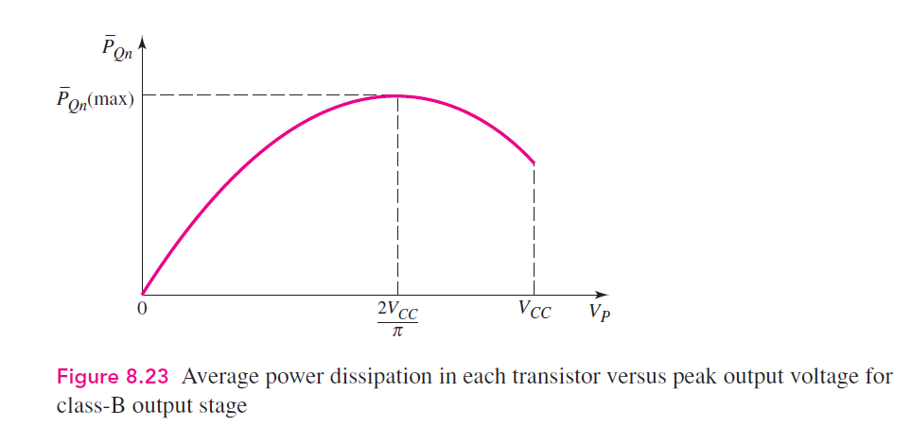


Efficiency of a push-pull amplifier
Deriving the expression obtained for P_{Qn}, and setting the derivative to zero one obtains

Slide 27
Class B amplifier: pros
Peak efficiency of the class B output stage is 78.5 %, much higher than class A.
Unlike class A, power dissipation varies with output amplitude.
Remember, there are two output devices so the power dissipation is shared between them. This eases the constraint on the power rating of the individual devices.

Slide 28
Cross-Over Distortion
A small base-emitter voltage is needed to turn on a transistor
Q₁ actually only conducts when v_{in} > 0.7 V
Q₂ actually only conducts when v_{in} < -0.7 V
When 0.7 > v_{in} > -0.7, Q1 and Q2 are both in cut-off and the output voltage is zero.

Slide 29
Actual Voltage-transfer characteristic
v_{out}
Q1 on
Q2 off
-V_{BE}
+V_{BE}
v_{in}
Q1 off
Q2 off
Q1 off
Q2 on

Slide 30
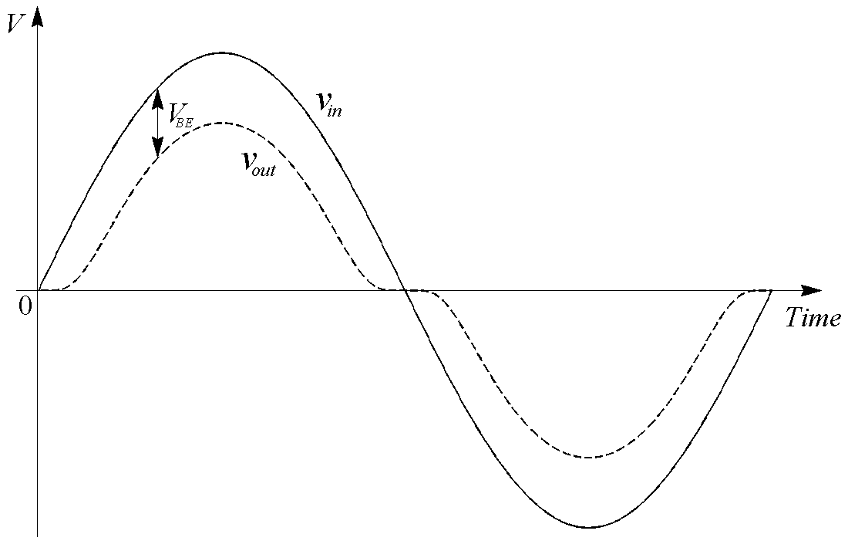
Effect of Cross-Over Distortion

Slide 31
Class B amplifier: cons
A class B output stage can be far more efficient than a class A stage (78.5 % maximum efficiency compared with 25 %).
It also requires twice as many output transistors…
…and it isn’t very linear; cross-over distortion can be significant.

Slide 32
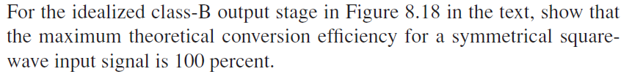
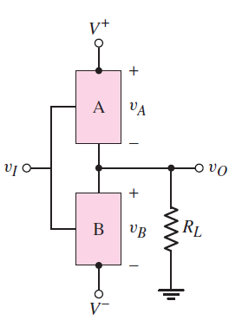
Lecture 24-In class-problem 1

Slide 33
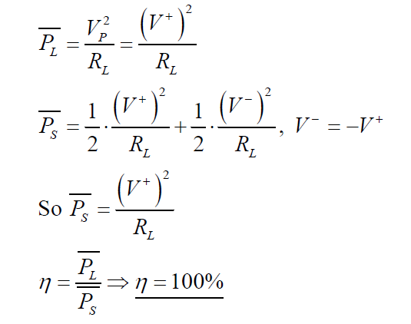
In class-problem 1, solution

Slide 34
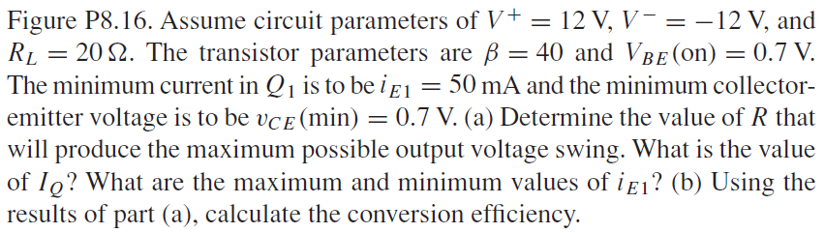
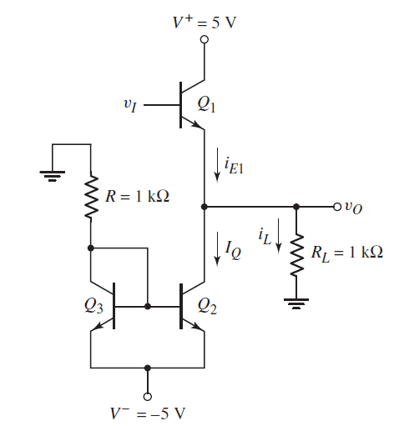
Take-home problem 1

Slide 35
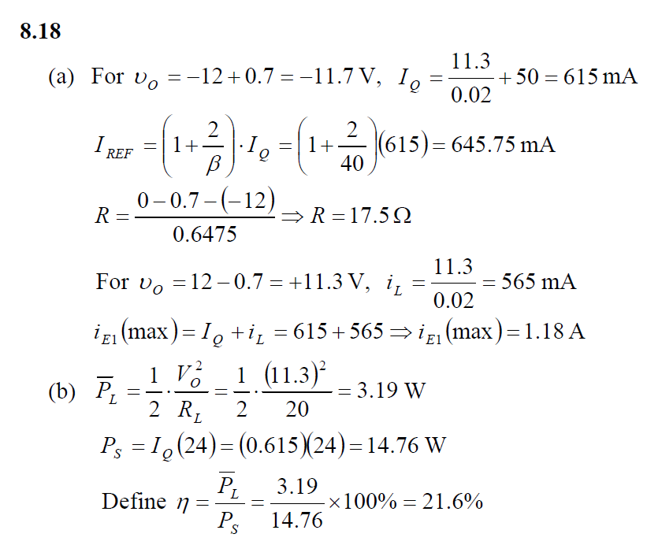
Take-home problem 1, solution

